Slide 1
STIX 3923 PROJECT 2 (F) Field Testing Presentation UUM Students Satisfaction Analysis Monitoring Tool (UUMSSAMT)
Presenter: Lim Yong Kang (279868)
Lecturer: Prof. Madya Ts. Dr. Maslinda binti Mohd Nadzir
Supervisor: Dr.Mohammad Sabri Bin Sinal @ Zainal

Slide 2
Overview
01
02
monitoring tool that allows to quickly analyse and present the sentiment of posts or comments.
Purpose - help users understand analysis result and details to implement the necessary solution to solve the real-life problems and improve the management of university.
Step to Use;
Input the post or comment
Accuracy part – show the number of positive, neutral, and negative word in percentage
Sentiment Result – result display in quantitative and qualitative form
Details – display list of positive and negative word, and showing the potential topic in the sentences
UUM Students Satisfaction Analysis Monitoring Tool (UUMSSAMT)

Slide 3

EVALUATION METHOD
Objective
Type of evaluation
1.To study the effectiveness and efficiency of the monitoring tool among the target user
2.To study the satisfaction and usability of the monitoring tool among the target user
3.To study the comment and suggestion of improvement towards the monitoring tool
User evaluation
USE questionnaire model
UUM Students Satisfaction Analysis Monitoring Tool (UUMSSAMT)

Slide 4
EVALUATION METHOD
Participants
20 management authorities and staff
Chancellery Department, Perpustakaan Sultanah Bahiyah, and School of Computing at the University Utara Malaysia (UUM)
Stratified sampling
Demographics – gender, age, education level and familiarity of technology
UUM Students Satisfaction Analysis Monitoring Tool (UUMSSAMT)

Slide 5

EVALUATION METHOD
Materials
Platform – Google Form
Six Section
Section A - User demographic
Section B - Easy to use.
Section C - Usefulness of UUMSSAMT
Section D - Ease Of Learning
Section E - Satisfaction of UUMSSAMT
Section F - List of aspect
Likert 5 points scale - section B until E
Scale | Description
1 | Strongly Disagree
2 | Disagree
3 | Neutral
4 | Agree
5 | Strongly Agree
UUM Students Satisfaction Analysis Monitoring Tool (UUMSSAMT)

Slide 6

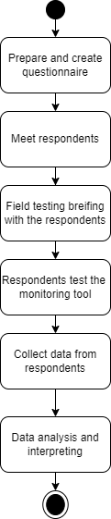
Procedure of conducting the evaluation
UUM Students Satisfaction Analysis Monitoring Tool (UUMSSAMT)

Slide 7
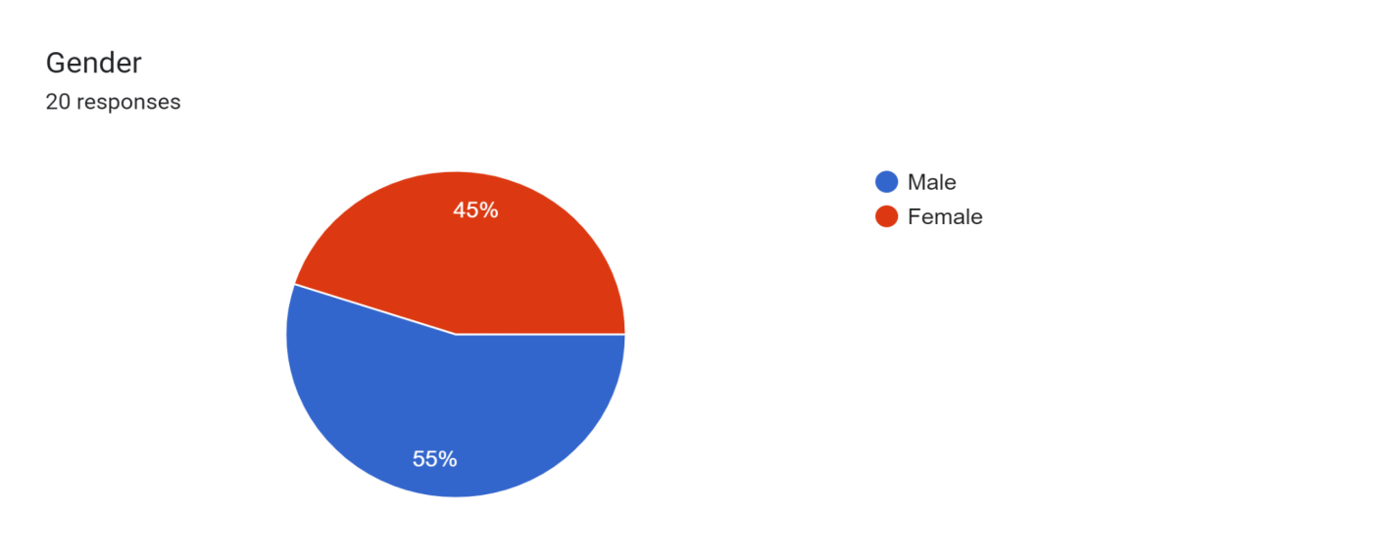
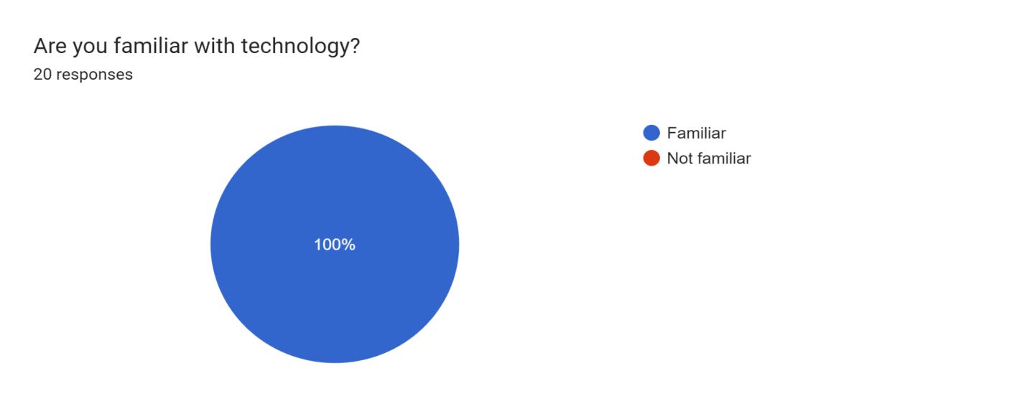
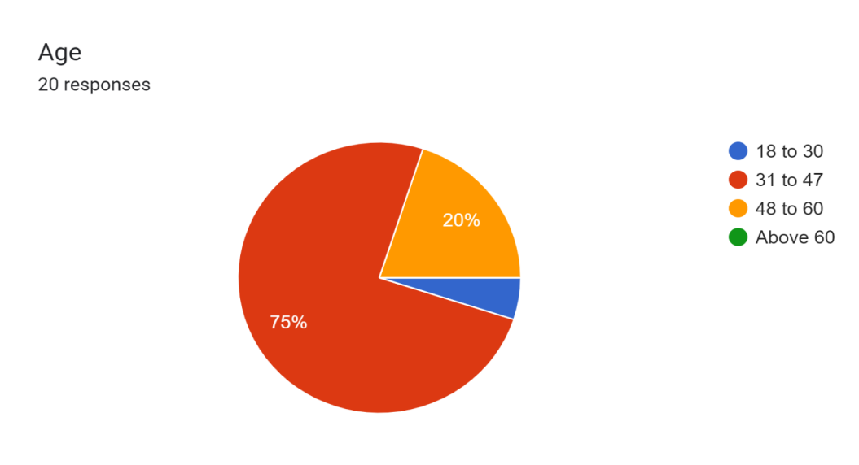
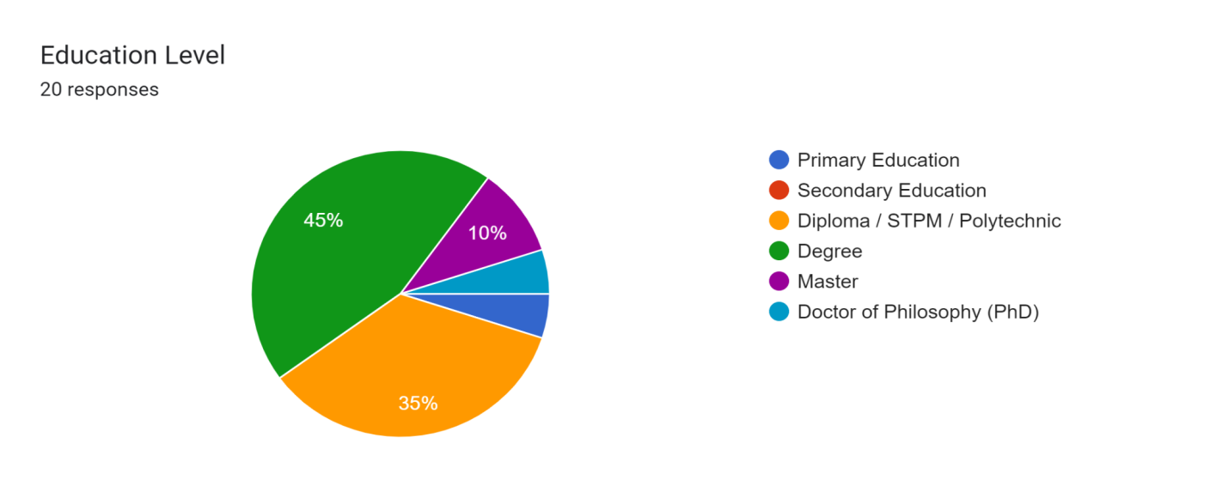
Finding
Demographic
UUM Students Satisfaction Analysis Monitoring Tool (UUMSSAMT)

Slide 8
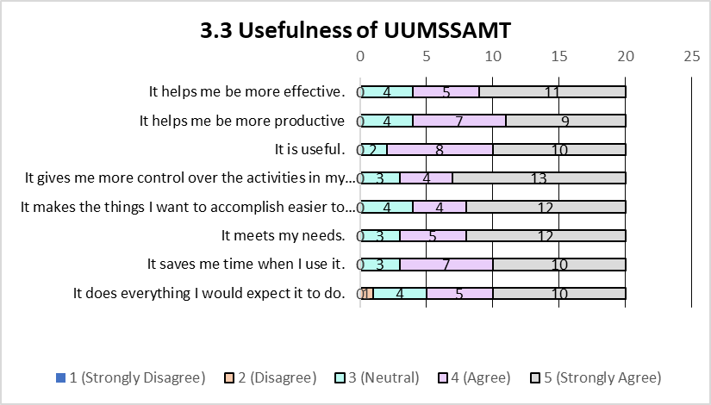
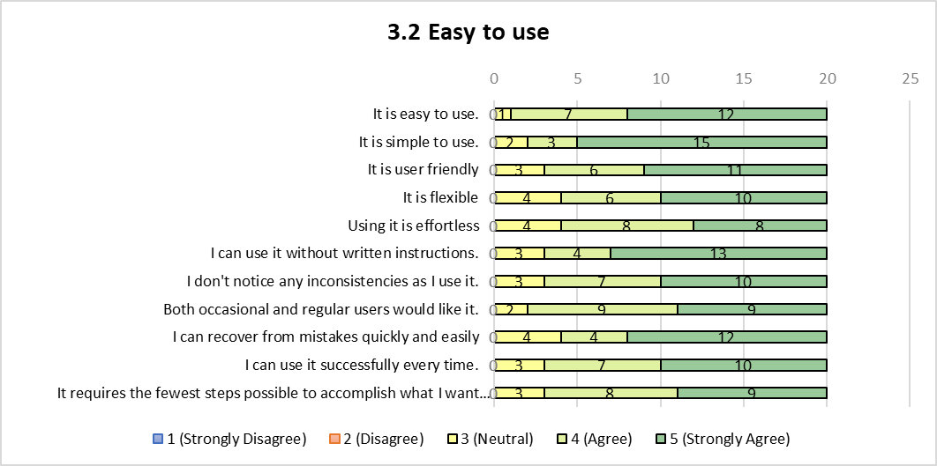
Finding
Ease to Use
Usefulness of UUMSSAMT
UUM Students Satisfaction Analysis Monitoring Tool (UUMSSAMT)

Slide 9
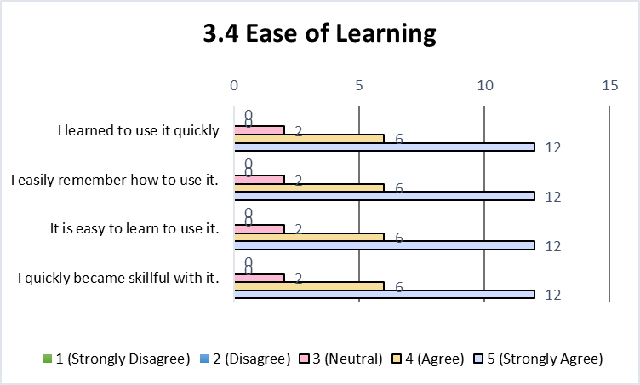
Finding
Ease of Learning
Satisfaction of UUMSSAMT
UUM Students Satisfaction Analysis Monitoring Tool (UUMSSAMT)

Slide 10
Implecation of result
Positive Aspect | Negative Aspect
Good logic Very convenient to use Produce sentiment of any statements good analyzing tool Can analyse the post and comment. Developer give very crystal clear instiction.. keep it up.. New approach and easy to use. | Not reflect uum student satisfaction dictionary can be improved to analyze based on sentences. Still have human error while copying and pasting. The system requires automatic analyze for better monitoring and fair.
UUM Students Satisfaction Analysis Monitoring Tool (UUMSSAMT)

Slide 11


Implecation of result
Most positive results & little of the negative aspect of the UUM Student Satisfaction Analysis Monitoring Tool.
Easy to use
Reached the minimum requirement of the sentiment analysis.
Suggestion on the monitoring tool;
Improve the dictionary to analyse the sentiment,
Provide a clear topic detection and automatic analyse by file.
UUM Students Satisfaction Analysis Monitoring Tool (UUMSSAMT)

Slide 12
Thank You!
Presenter: Lim Yong Kang (279868)
Lecturer: Prof. Madya Ts. Dr. Maslinda binti Mohd Nadzir
Supervisor: Dr.Mohammad Sabri Bin Sinal

